Slide 1
Module-2 Introduction to cryptography
By Dr. Sanjeev Kumar Mandal

Slide 2
Definitions
Computer Security - generic name for the collection of tools designed to protect data and to thwart hackers
Network Security - measures to protect data during their transmission
Internet Security - measures to protect data during their transmission over a collection of interconnected networks

Slide 3
Some Basic Terminology
Plaintext - original message
Ciphertext – a coded message
Cipher - algorithm for transforming plaintext to ciphertext
key - info used in cipher known only to sender/receiver
Encipher (encrypt) - converting plaintext to ciphertext
Decipher (decrypt) - recovering ciphertext from plaintext
Cryptography – the study of encryption principles/methods
Cryptanalysis (codebreaking) – the study of principles/ methods of deciphering ciphertext without knowing key
Cryptology - field of both cryptography and cryptanalysis

Slide 4
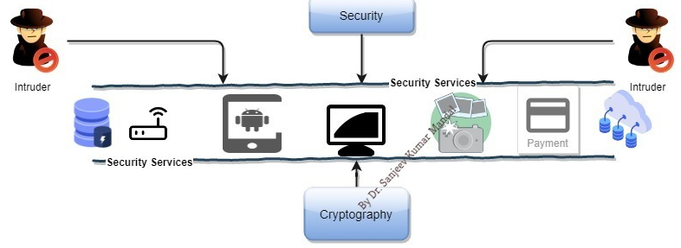
Why Encryption?
Encryption is what keeps your personal data secure when you're shopping or banking online. It scrambles data like your credit card details and home address to ensure hackers can't misuse this information.

Slide 5
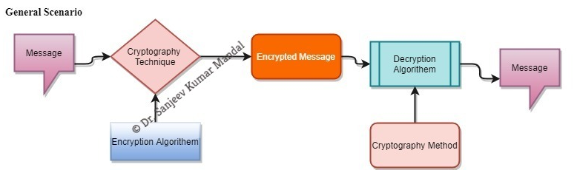
What is Cryptography?
The art and science of concealing the messages to introduce secrecy in information security is recognized as cryptography.
Plaintext
Encryption Algorithm
Ciphertext
Decryption Algorithm
Plaintext

Slide 6
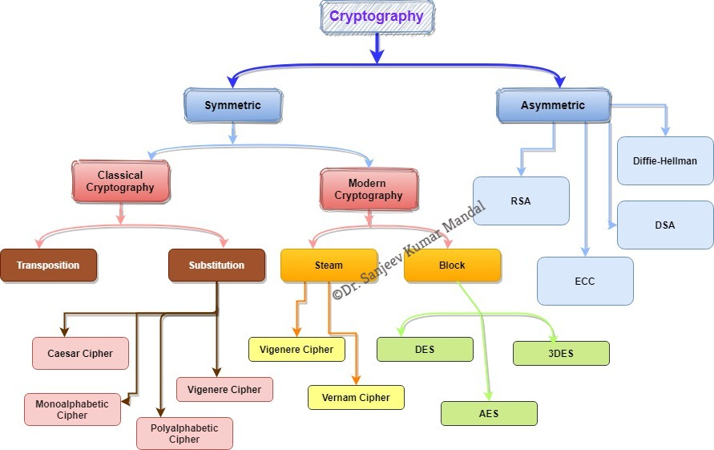
Cryptography is divided into 3 into depended dimensions
Operation is used to transform plaintext into ciphertext(Substitution & transposition)
The Number of Key (Symmetric/Asymmetric)
The way in which the plaintext is processed (Block/Steam)

Slide 7
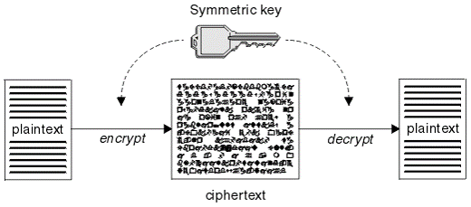
Symmetric Encryption
A symmetric encryption is any technique where the same key is used to both encrypt and decrypt the data.
Types
Classical Cryptographic
Modern Cryptography

Slide 8
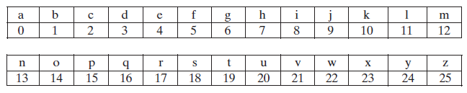
Substitution Cipher Technique
Caesar Cipher: The Caesar cipher involves replacing each letter of the alphabet with the letter standing three places further down the alphabet.
For example: Shift << 3
plain: MEET ME AFTER THE TOGA PARTY
cipher:PHHW PH DIWHU WKH WRJD SDUWB
Algorithm can be expressed as follows. For each plaintext letter p, Key K and Ciphertext letter C.
Encryption :- C = E(k, p) = (p + k) mod 26
C = E(3, m) = (12 + 3) mod 26 = 15 ------> Letter p
Decryption :- p = D(k, C) = (C - k) mod 26

Slide 9
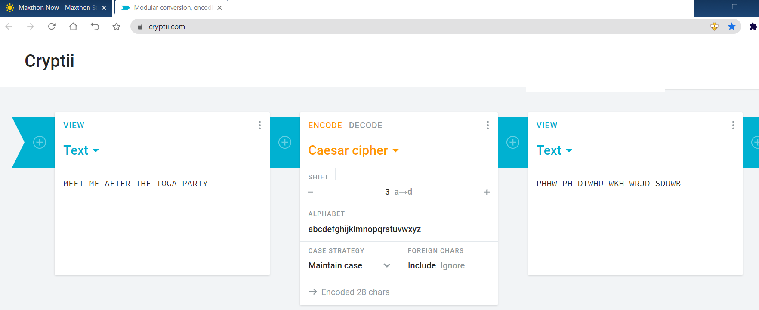
Example:

Slide 10
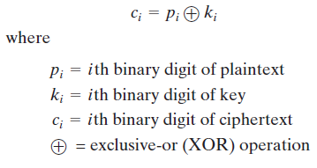
VERNAM CIPHER
The Vernam Cipher is based on the principle that each plaintext character from a message is 'mixed' with one character from a key stream.
Example:
Plain: sanjeev
Binary Value is: 01110011 01100001 01101110 01101010 01100101 01100101 01110110
Key: jain
Binary Value: 01101010 01100001 01101001 01101110
Afetr XOR Encryption
Ciphertext: 00-00-00-01-01-00-00-01-00-00-00-00-00-00-00-00-00-00-00-00-00-00-00-01-01-01-00-00-00-00-00-00-01-00-00-10-01-00-01-01-00-00-00-11-10-01-00-01-00-00-01-01-11-10-01-00-01-00-00-01-00-10

Slide 11
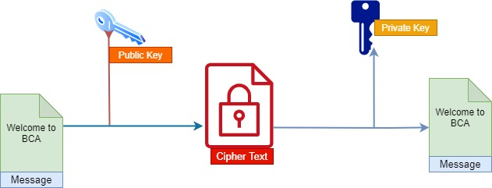
Asymmetric Encryption
RSA
Diffie Hellman
DSA
ECC

Slide 12


